Slide 1
Chapter 2 -Radio Frequency Identification (RFID)Technology
Dr. Vinayak Ashok Bharadi

Slide 2
RFID
Introduction,
Principle of RFID,
Components of RFID system: RFID Tag, Reader, RFID Middleware,
RFID issues

Slide 3
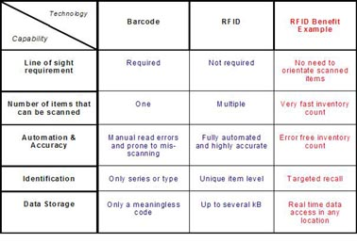

Slide 4
RFID VS Barcodes
1. Line-of-sight is NOT needed to read RFID tags
2. Hundreds of tags can be read in seconds
3. RFID Tags can be very durable
4. RFID Tags can hold more data than other types of tags and
labels
5. Read range for an RFID system can be controlled as needed -
from less than 1m, up to 150 meters
6. Tags can be encrypted or locked for security
7. Tag memory can be rewritten and reused

Slide 5
HOW DOES RFID WORK?
RFID belongs to a group of technologies referred to as Automatic Identification and Data Capture (AIDC).
RFID methods utilize radio waves to accomplish this. At a simple level, RFID systems consist of three components:
RFID tag or smart label,
RFID reader, and
Antenna.
The reader then converts the radio waves to a more usable form of data. Information collected from the tags is then transferred through a communications interface to a host computer system, where the data can be stored in a database and analyzed at a later time.

Slide 6
RFID APPLICATIONS
– Inventory management
– Asset tracking
– Personnel tracking
– Controlling access to restricted areas
– ID Badging
– Supply chain management
– Counterfeit prevention (e.g. in the pharmaceutical industry)

Slide 7
History
The first RFID application was the "Identification Friend or Foe" system (IFF) [Wizard Wars] and it was used by the British in the Second World War. Transponders were placed into fighter planes and tanks, and reading units could query them to decide whether to attack. Successors of this technology are still used in armies around the world.
The probably first paper related to RFID technology was the landmark paper by Harry Stockman, "Communication by Means of Reflected Power" in October 1948.
The first patent on RFID was issued in 1973 for a passive radio transponder with memory [US. Patent 3,713,148].

Slide 8
RFID Principle
RFID tags, or simply "tags", are small transponders that respond to queries from a reader by wirelessly transmitting a serial number or similar identifier.

Slide 9
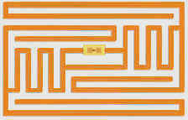
Current RFID Technology
RFID transponders (tags) consist in general of:
Micro chip
Antenna
Case
Battery (for active tags only)
The size of the chip depends mostly on the Antenna. Its size and form is dependent on the frequency the tag is using. The size of a tag also depends on its area of use. It can range from less than a millimeter for implants to the size of a book in container logistic
In addition to the micro chip, some tags also have rewritable memory attached where the tag can store updates between reading cycles or new data like serial numbers.
Figure 1: A passive RFID tag
The microchip is visible in the center of the tag, and since this is a passive tag it does not have an internal power source.

Slide 10
RFID Principle
the reading unit generates an electro-magnetic field which induces a current into the tag's antenna.
The current is used to power the chip. In passive tags the current also charges a condenser which assures uninterrupted power for the chip.
In active tags a battery replaces the condenser.
Once activated the tag receives commands from the reading unit and replies by sending its serial number or the requested information. In general the tag does not have enough energy to create its own electro-magnetic field, instead it uses back scattering to modulate (reflect/absorb) the field sent by the reading unit.

Slide 11
During a reading cycle, the reader has to continuously power the tag. The created field is called continuous wave, and because the strength of the field decreases with the square of the distance the readers have to use a rather large power.
That field overpowers any response a tag could give, so therefore tags reply on side-channels which are located directly below and above the frequency of the continuous wave.

Slide 12
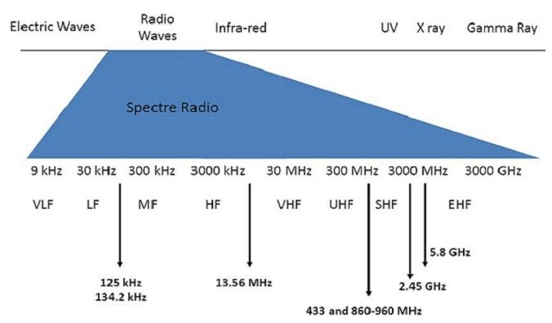

Slide 13
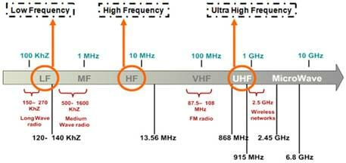

Slide 14
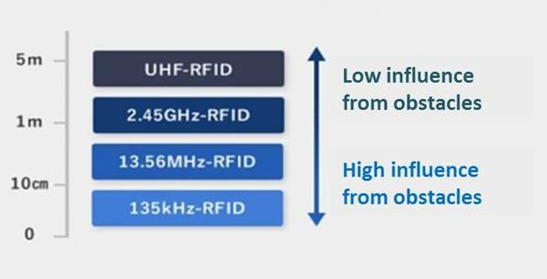

Slide 15
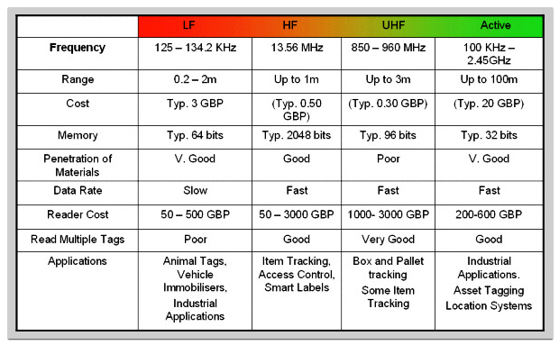

Slide 16
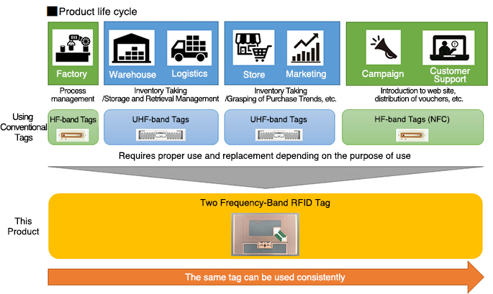

Slide 17
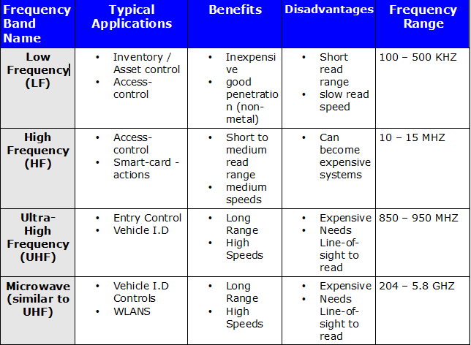

Slide 18
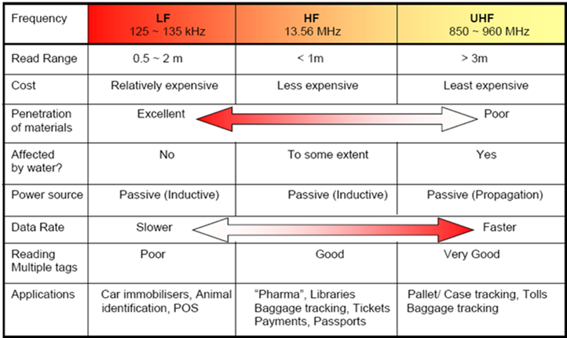

Slide 19
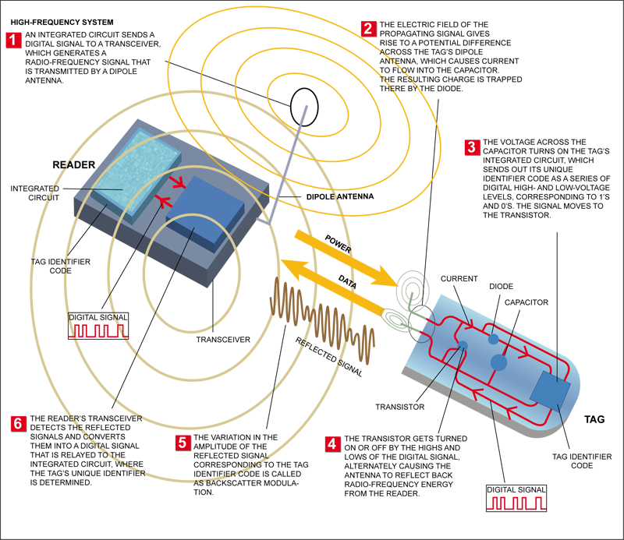

Slide 20
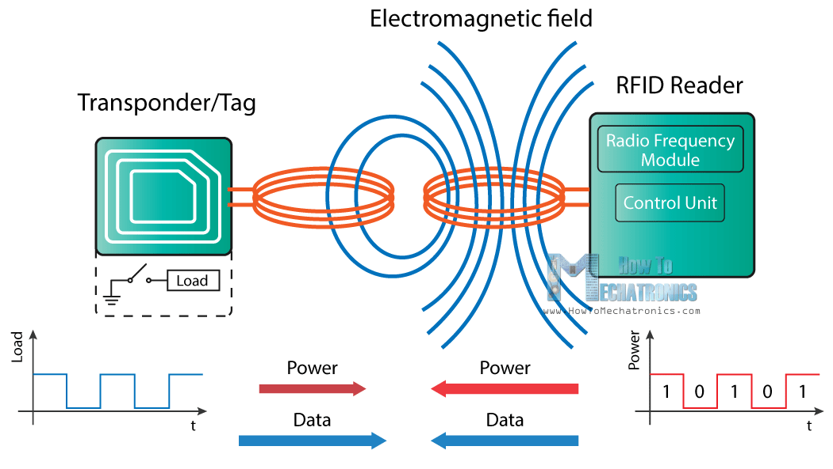

Slide 21
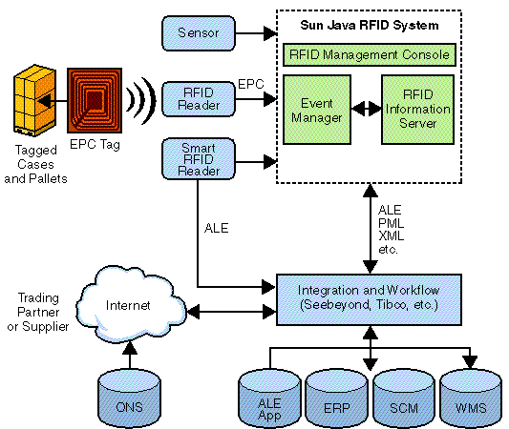
RFID Application Architecture

Slide 22
Energy Sources
We distinguish 3 types of RFID tags in relation to power or energy:
Passive
Semi-passive
Active

Slide 23
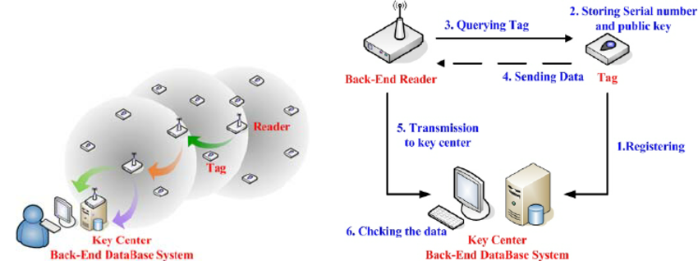

Slide 24
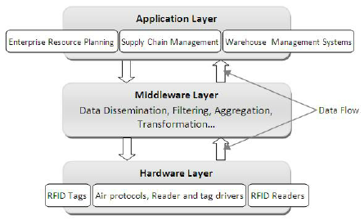
Layers in RFID Implementation

Slide 25
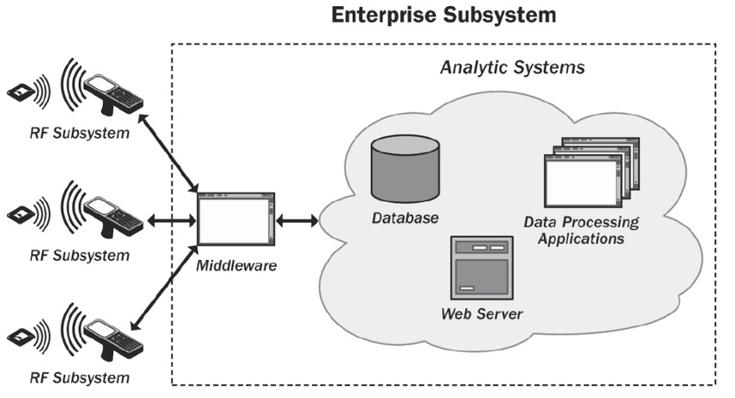

Slide 26
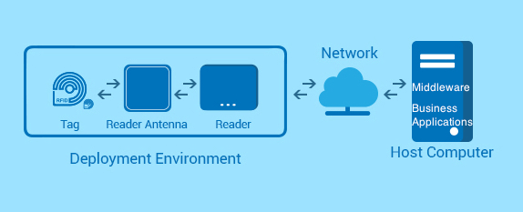
RFID Middleware

Slide 27
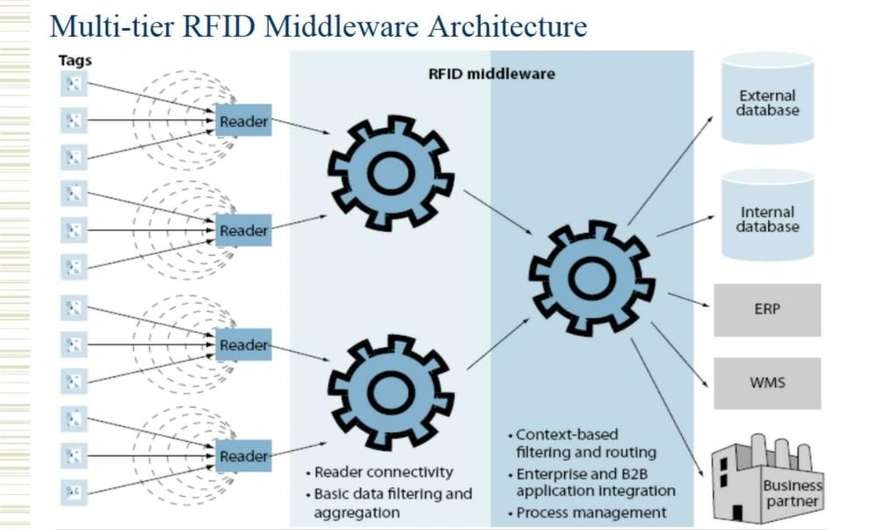

Slide 28
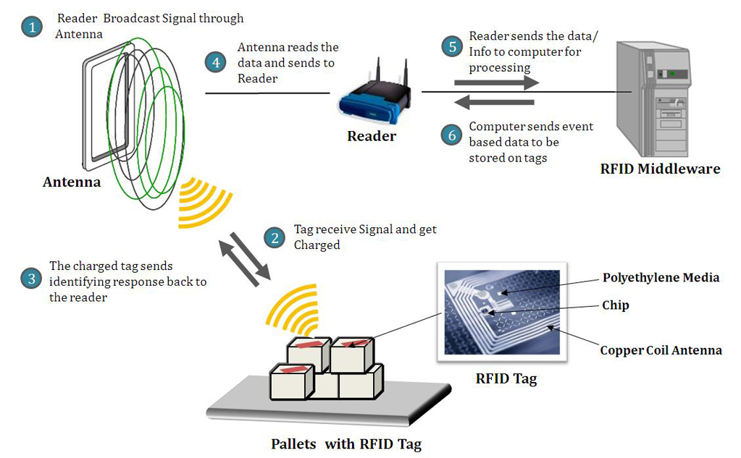
Process flow :

Slide 29
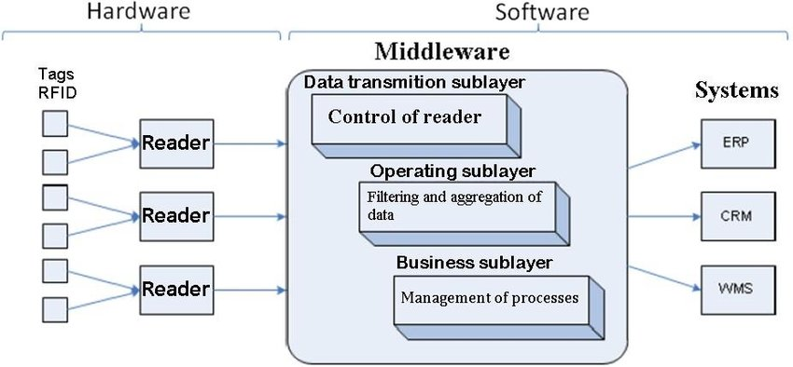
RFID Middleware

Slide 30
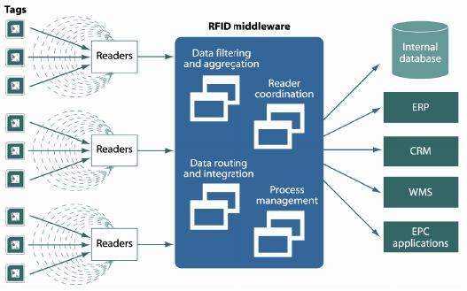

Slide 31
RFID Issues-
1. Technology related.
2. Privacy and ethics related.

Slide 32
RFID can be more costly:
Whether it be software or hardware, RFID requires more costly equipment that needs to be maintained through the life of the solution. Additionally, tags, whether they be Active, Passive or Semi-Passive, can set a business back a ways. Although prices have fallen with RFID upgrades since the 1970s, businesses are still taking a pass because of the steep prices.

Slide 33
RFID Reader Collision
Reader collision occurs when the signals from two or more readers overlap. The tag is unable to respond to simultaneous queries. Systems must be carefully set up to avoid this problem; many systems use an anti-collision protocol (also called a singulation protocol. Anti-collision protocols enable the tags to take turns in transmitting to a reader. (Learn more about RFID reader collision.)

Slide 34
Trouble with metals and liquids
RFID has long had a difficult relationship working among liquids and metals, as both make it harder to get proper reads on assets. With metal, the problem stems from the radio waves bouncing all over the place. Liquids play havoc with RFID in that it can absorb signals sent from a tag.

Slide 35
RFID Tag Collision:
It occurs when there are many of the cards found in a small area, in addition to the reading time is short, so it is easy for vendors to develop systems that ensure a response card and only one by employing the appropriate algorithms.

Slide 36
Security, privacy and ethics problems with RFID
The contents of an RFID tag can be read after the item leaves the supply chain
RFID tags are difficult to remove
RFID tags can be read without your knowledge
RFID tags can be read without your knowledge
RFID tags with unique serial numbers could be linked to an individual credit card number

